Slide 1
Notes On Workload
Mike Goodrich, Eric Mercer
TJ Gledhill, Robert Ivie, Jared Moore
Brigham Young University

Slide 2
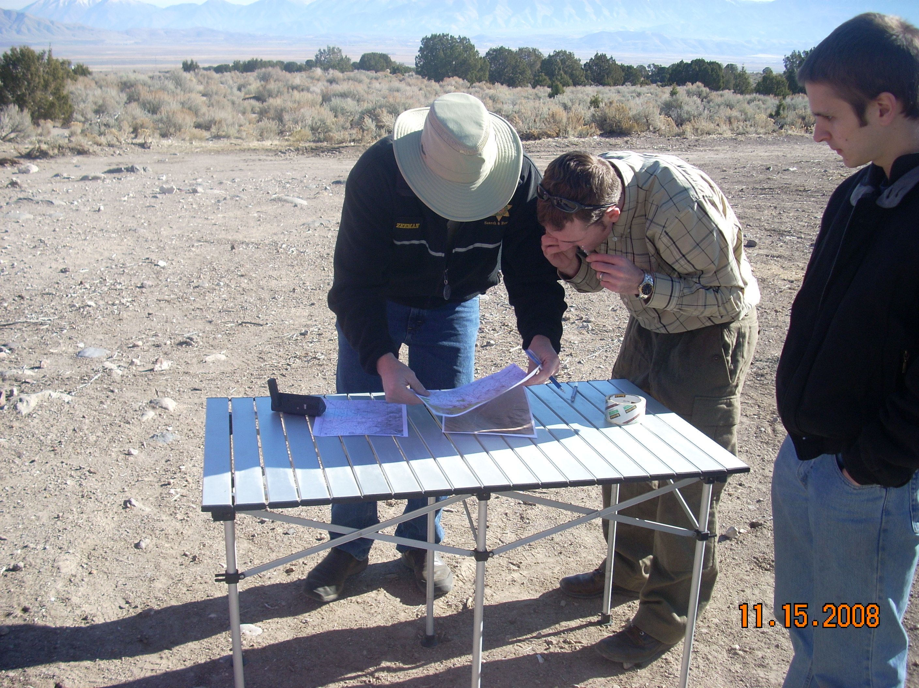
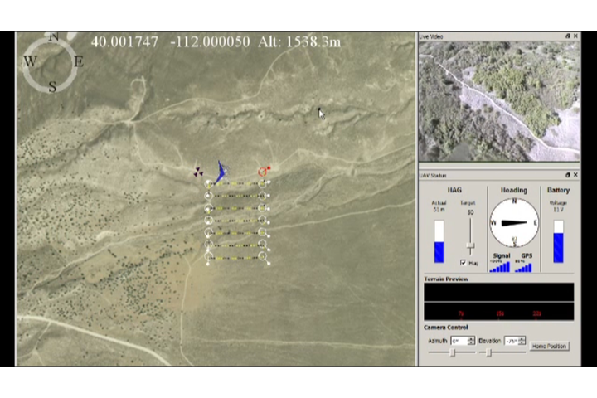
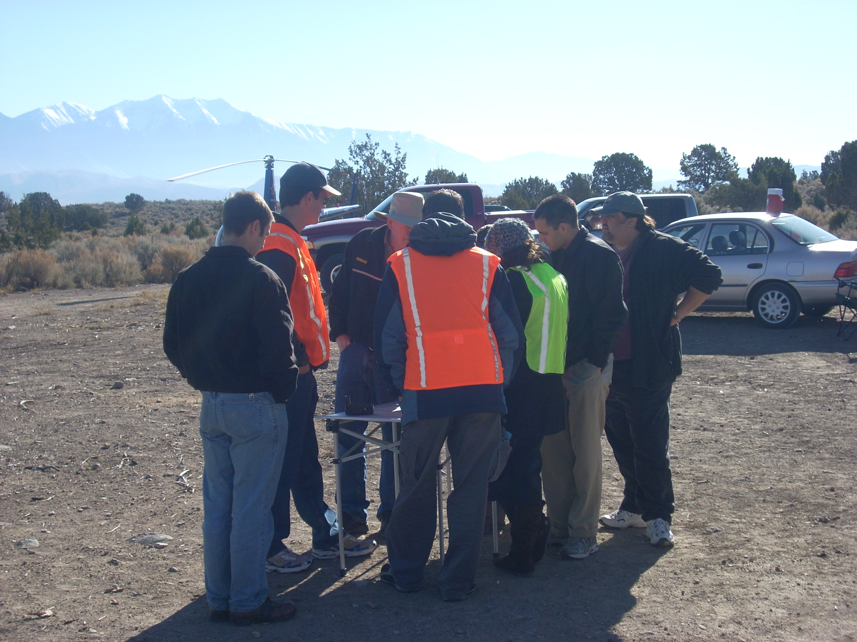
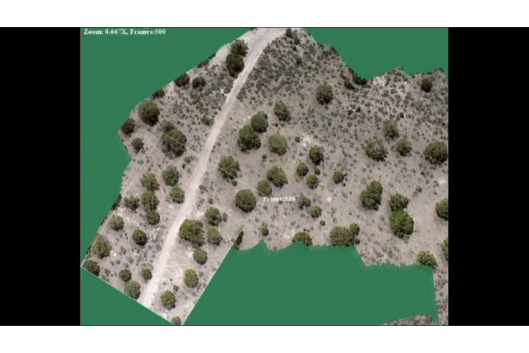
Too Many Humans per UAS
Problem Holder
UAV Operator
Stake Holders
Video Analyst
Notes:
Problem Holder: Incident Commander, Mission Control, Commander
Stake Holders: Ground Searchers, Scientists, Soldiers
UAS requires several human operators to accomplish a given mission
UAS is also part of a larger team and needs to interact with stake holders and problem holders
Workload impacts UAS operators and influences team interaction
The number of needed humans makes deploying UASs prohibitive
How do we improve the UAS system to require fewer humans at workload while improving team interaction?

Slide 3
Fewer Humans and Better Workload
Combine Individual Human Roles
Fewer Required Humans
Create Justifiable GUIs
Decreased Human Workload
Increase and Validate Autonomy
Notes:
GOAL: Optimize UAS systems to require fewer human resources and operate in a team setting through increased automation and better interfaces

Slide 4
Goal: Workload Fusion
Parent Operation
Video Analyst
Mission Manager
UAV Operator
Video GUI
UAV GUI
Physical World
Notes:
With an understanding of workload, use that understanding to redesign the system
Combine roles and reassess the workload
Change the GUI and reassess the workload
All the while, use the model checking to verify the mission is still being achieved.
The model informs the design.
Once the new system exists, use the model to in a monitor role to detect when the operator deviates from normal behavior.
Design the GUI to inform the user in the presence of deviation, and then use a narrative to inform the user of potential outcomes and counter-responses, encoded in the model, from other team members or agents in the system.
The GUI informs the user of deviation and negotiates potential outcomes

Slide 5
Research Objectives
Model
Capture system dynamics in model
Verify
Model-check workload dynamics
Metrics
Measure workload using the model
Validate
Model-check workload dynamics
Monitor
Negotiated deviation informed by model
Test
Perform sensitivity study to test metrics
Design
Create new single operator system
Create
Port optimized GUI from model to machine
Notes:
Our Goals are (a) to find ways to reduce the number of operators for UAV tasks and (b) to design GUIs that support these operators better by helping them manage workload.

Slide 6
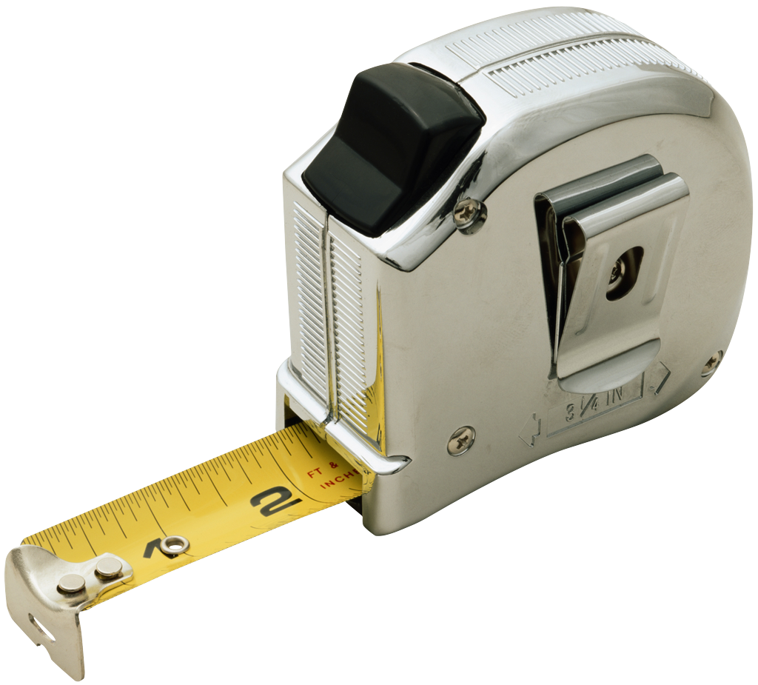
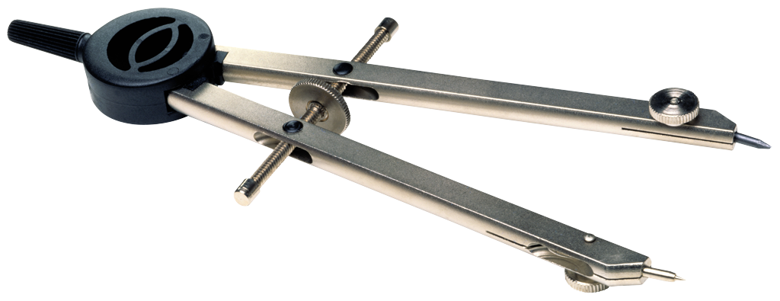
How do you model a UAS?
UASs are complicated and missions evolve
Any model is inherently incomplete
Encode nominal human activities
Then add extra-model activity
And see what happens
Extra-model activity mimics an evolving mission
Notes:
Extra-model activity influenceds

Slide 7
Directed Team Graph (DiTG)
DiTG = {Channel, …}
Channel = (channelType, source, target, i/o)
Parent Search
Mission Manager
Operator
Video Operator
Operator GUI
Video Operator GUI
UAV
Notes:
In our specific system, we obtain workload metrics by watching the activity of the directed team graph.
The graph consists of the actors in the team, or system, and their channels of communication.
Each agent is modeled by a state machine.
Each communication channel is modeled by a wire from one actor to another.

Slide 8
Directed Team Graph (DiTG)
Parent
Search
V
A
V
A
Mission
Manager
Notes:
More specifically the channels are built as a group of unidirectional wires.
These can then be counted and load tested.

Slide 9
Model Checking
Formal analysis of UAS model
Does the system complete it mission?
What is the workload profile?
Model checking to informs the new design
Must first figure out how to measure workload
Notes:
Model Checking formally analyzes the model
The first goal of model checking is simply to verify the mission meets its objectives and outcomes
Even in the presence of the extra-model behavior
If the model fails, then change the nominal human responses until the mission succeeds
The second goal of model checking is to understand the dynamic workload profile.
Workload evolves over time and is a dynamic property of the system
Model checking is able to find scenarios with high/low workload
Target automation or GUI support to smooth out the workload profile
Once workload is managed, combine roles so fewer humans are needed

Slide 10
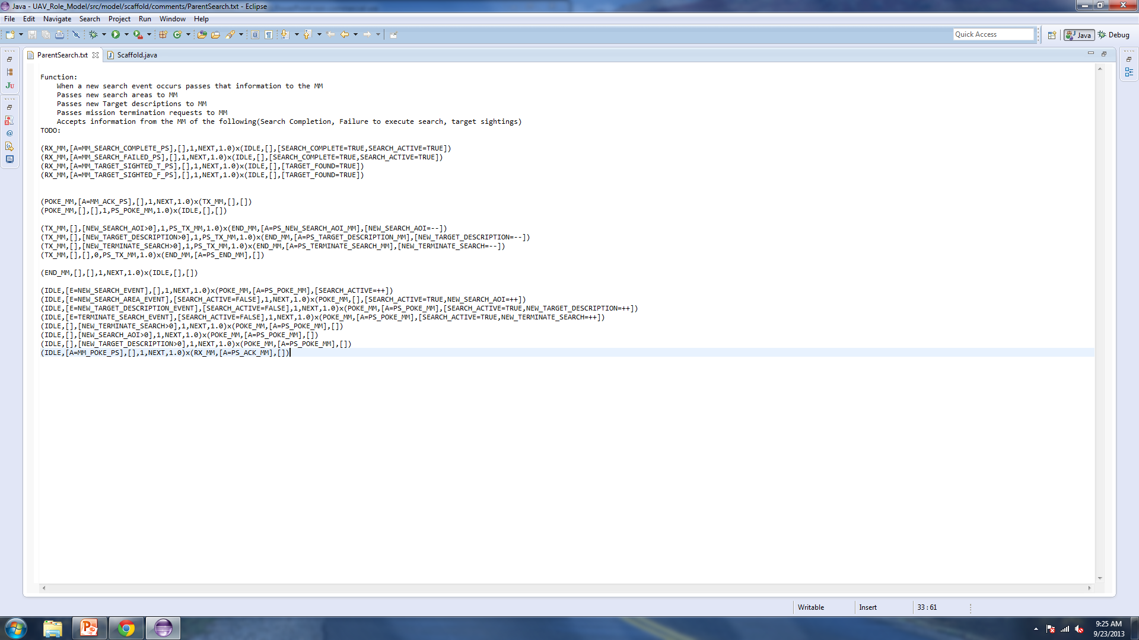
Formally Defined Model
($Σ, \left[Χ= χ\right],\left[Ψ= ψ\right], Α, Δ, Π$) x ($Σ′, \left[Χ′= χ\right],\left[Ψ′= ψ\right]$)
$$\left(currentState , \left[channel=input,…\right], \left[memory=input, …\right], priority, duration, probability\right)x$$
$(nextState, \left[channel=output,…\right], [memory=output, …])$
Notes:
To ensure that our Model is rigorous we defined a transition language, similar to a Kripke structure, that defines each possible transition an agent can make.
The Model also gives us the ability to tweak certain aspects with ease. For instance, when we want to see what happens when an actor happens to be really bad at his job we can adjust durations.

Slide 11
Model Checking
This actor never has more than 5 enabled transitions.
A
B
E
C
D
F
G
H
I
J
K
Notes:
Since we are using a formally defined model we can make inference about certain safety properties.

Slide 12
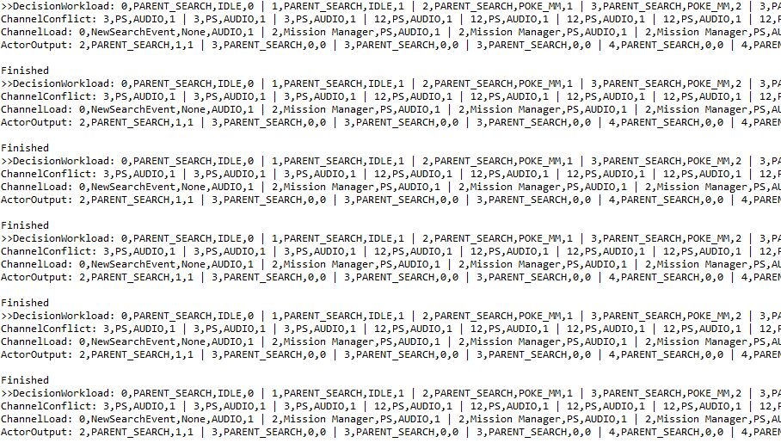
Java Path Finder
Notes:
JPF helps us verify and validate our model. It alone can perform most of the bug checking, without any help.
through JPF listeners and Java asserts we can validate safety properties throughout the system and along every branch relatively quickly.
Now we can model, verify, and validate even extremely complex systems without much pain.

Slide 13
How do we measure workload in our DiTG?
Understand workload in general (cognitive, temporal, team, and decision)
Find approximations (or implicit manifestations) in our DiTG and measure those approximations
Use model checking to find high/low scenarios
Do a sensitivity study to how workload reacts to model changes (random and purposeful)
Do a field study on humans to see if their perceptions match model measurements
Notes:
Overview of what follows.

Slide 14
Categories of Workload
Cognitive
Team
Temporal
Algorithmic
Notes:
Let’s talk about the different theoretical categories of workload. Here we have them listed as Cognitive, Team, Temporal, Algorithmic. We will go into a more in depth description of these categories momentarily. Afterwards we’ll map them to the specific metrics we’re using in our model.

Slide 15
Team / Organizational
Group Decision-Making
Group Memory
Agent’s know different things
Memory is transactive (Wegner)
Communication (Arrow)
Localized
Intent (model informs interpretation)
Required Mental Models (Fiore)
Teammate model: how is a task performed
Team interaction model: what topology
Team task model: who does & knows what
(Agent, Info)
(Task, Authority)
Notes:
Organizational workload describes how a team works together.
Key factors are:
First group decision-making,
or rather when more than one agent is required to choose the next immediate direction.
Second group memory,
or rather when more than one agent is storing information required to choose the next immediate direction.
Third communication,
or rather when intent is passed from one actor to the next.
Fourth required mental models,
or rather competency or performance of team members.
Ex: Video operator requesting a flyby from the UAV Operator.

Slide 16
Algorithmic
Difficulty of Problems
Solution depth
Perceive
Think
Act
Solution Algorithms
Space complexity
Time complexity
Notes:
Algorithmic workload describes the expected difficulty of bringing a task to completion.
An agent is constantly cycling between the three parts: perceive, think, and act.
During the perceive part he gathers input.
During the think part he decides what to do with the input.
During the act part he follows through, or not, with the decision.
Each of these parts will vary in workload, depending on the agent. The solution depth, in a sense a part of think, is something an experienced agent would use to decide which of all available options should be used next.
Ex: Mission Manager starting a mission.

Slide 17
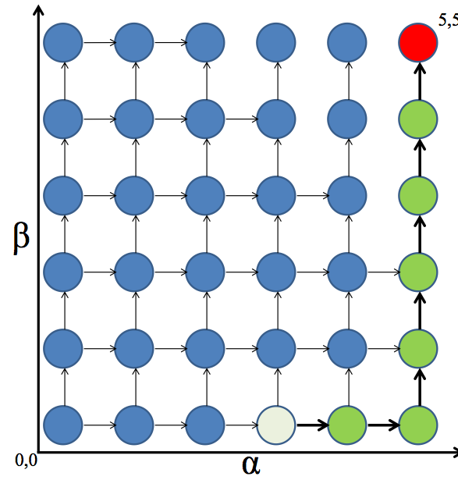
Temporal
Next State Constraints
Order: which comes first
Timing: deadlines
Operational tempo
Manage pacing of tasks
Fan-out (repetitive tasks)
Task neglect tolerance
Task interaction time
Tasks:
α,β
Constraints:
α_{T}≤ 7
NT
IT
IT
IT
Notes:
Temporal workload explains the effects of prioritized, infrequent, or repetitious tasks.
Constraints may exist, like an agents inability to enter a response state before asking permission of another agent.
High or low op-tempo can often lead to poorly task performance when the agent can’t complete, or forgets to complete a task by the next specified deadline.
A few good examples of this are packet scheduling algorithms or queuing theory.
Highly repetitive tasks are incredibly annoying, and also contribute to temporal workload.
Ex: UAV Operator alternating between observing the UAV by line of sight or via the GUI.

Slide 18
Cognitive
Haptic
Auditory
Parallel
Sensing
Visual
Sequential
Decision-Making
Notes:
Cognitive workload describes difficulties produced by confusing neural signals.
Parallel sensing increases cognitive workload.
Think about the difficulty or perception when stimuli are different and simultaneous.
Size of the stimuli also effect cognitive workload.
Often these stimuli are large, an instruction booklet for instance, and must be consumed without interference.
Ex: The UAV Operator trying to respond to the a warning from his GUI and request from the Video Operator simultaneously.

Slide 19
What Causes “Work”
Channel conflicts
Shared memory conflicts
Teaming mental models
Communication issues
Cognitive
Team
Temporal
Algorithmic
“Reload” working memory
“Refresh” perceptual channels
Temporal conflicts
Task complexity
Memory saturation
Notes:
Before we make the mapping to our specific metrics, let’s recall the different aspects of workload.
Team/Organizational
Agent Mental Models
Communication
Group Memory
Group Decision Making
Algorithmic
Task Complexity
Temporal
Op-Tempo
Cognitive
Parallel Sensing
Stimuli Load/Size
These theoretical categories are crucial to understanding expected workload.

Slide 20
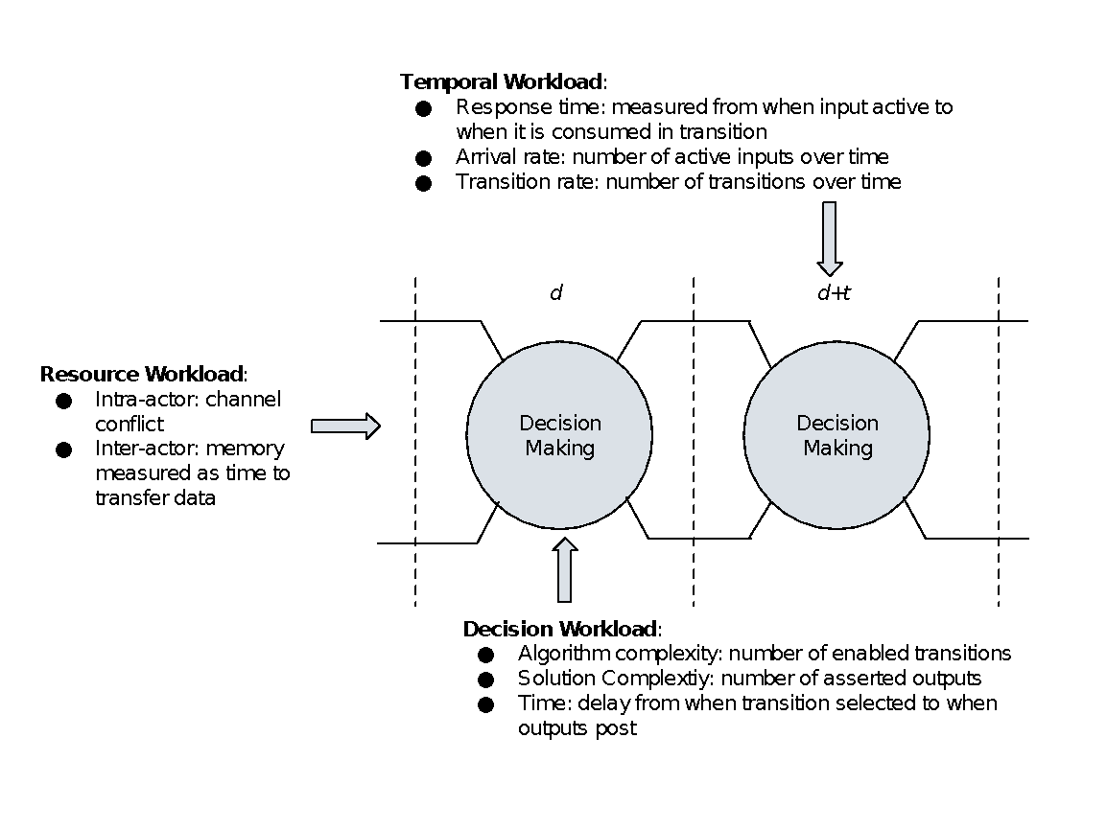
Model-Based Workload Metrics
Notes:
Recall that workload is a (task portfolio, agent) pair. Our set of task workload metrics is based on particular model of the agent. Therefore, our workload metrics assume that agent expertise is fixed, that is, it is encoded in the model. Thus, we are measuring the effects of task portfolio on the workload time history. If we try different models, we can get a feel for how agent expertise comes into play. This is a useful way to think because it helps us articulate the limitations of our model.

Slide 21
Metric Classification
Resource
Team
Temporal
Decision
Notes:
Here is the mapping from the theoretical workload categories to our classifications of workload metrics.
Cognitive becomes Resource
Temporal remains the same
Algorithmic becomes Decision
Team remains the same
While we currently haven’t set up our system to gather team metrics, we speculate that they wont be difficult to gather.
Now lets talk about the metrics and how the are gathered.

Slide 22
Resource Workload
Parent
Search
V
A
V
A
Mission
Manager
Notes:
Let’s take a closer look. Look at this transition for a hypothetical agent. We clearly see three active channels. Further diagnosis of these channels might show that one happens to be an audio channel, while the other two are both visual channels. Also, one of those visual channels took twice as long to pass its data as the other channel. From this diagnosis we get a clear picture of this agent’s resource workload at this time.

Slide 23
Decision Workload
Mission Manager
Idle
Talk with Video
Operator
Talk with UAV Operator
Notes:
Now we see that our theoretical agent has a choice to make. Given the three active channels he has concluded that he has three possible paths which he can take. This might be abnormal for him, and he struggles for a moment before he decides which is the best path to take.

Slide 24
Temporal Workload
Transition Frequency
Mission Manager
Notes:
Our agent faces another challenge. This same process keeps repeating. More precisely, the same inputs are active over and over again. He keeps making the same decision over and over again. When will this end?

Slide 25
What Causes “Work”
Number of Active Channels
Transition Duration
Resource
Team
Temporal
Decision
Rate of Transition
Number of Enabled Transitions
Notes:
During this hypothetical simulation a few metrics stand out.
Transition Duration
Number of Active Channels
Number of Enabled Transitions
Rate of Transition
These metrics can be found using our code.

Slide 26
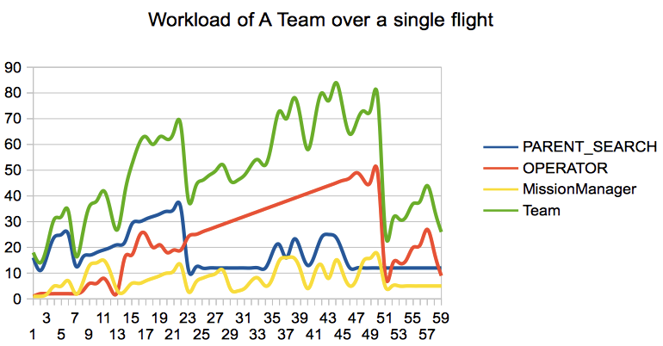
Results: Workload Estimates
Notes:
The slide conveys an aggregate workload over time for for each actor. Notice the workload spikes. We are working to understand the profile and use the model checker to find high/low workload scenarios that can be validated in field study.

Slide 27
What Can Modeling Tell Us About Workload?
Workload Elements
Model Checking
Model Specs
Workload Management
Notes:
Applying tools, like model checking and detailed specifications, to a model allows us to accurately simulate and manage workload.

Slide 28
Future Work
Sensitivity Study
Generalized Model
Optimized WiSAR GUI
Notes:
Through a sensitivity study we want to ensure that our current metrics are working, in other words we have to know what we think we are measuring is what we really are measuring.
Once we know this for certain, we can produce a formally verified and validated GUI for the WiSAR system, and release generalized that other people can also use for their V&V.

